Slide 1
Communication
A resource of Proudly Safe SA

Slide 2

ACKNOWLEDGEMENT OF COUNTRY
We acknowledge and respect the Traditional Custodians of the country throughout Australia and their continuing connection to land, sea and community. We recognise the diversity of Aboriginal people and the importance of land, culture and heritage to the Elders and their communities.

Slide 3


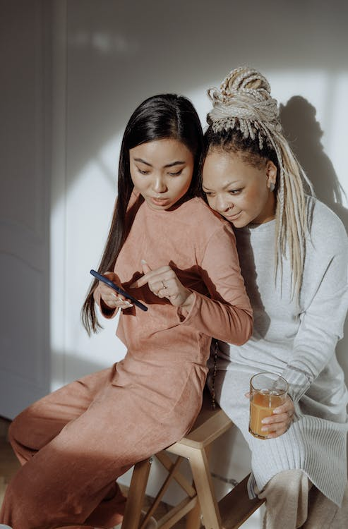
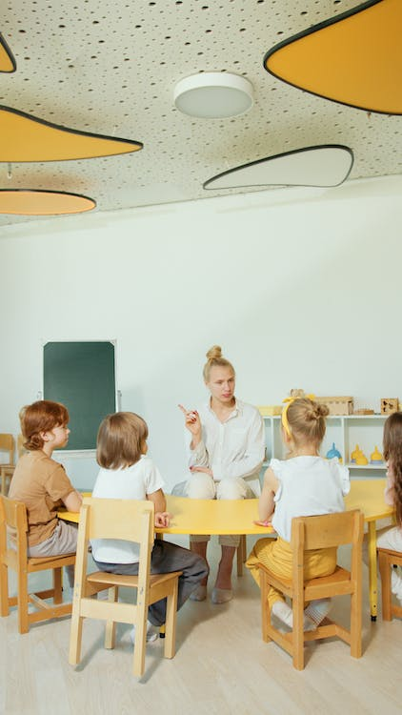
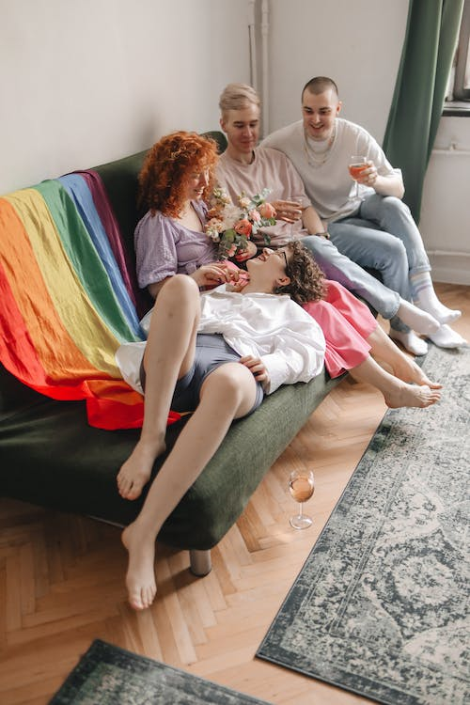
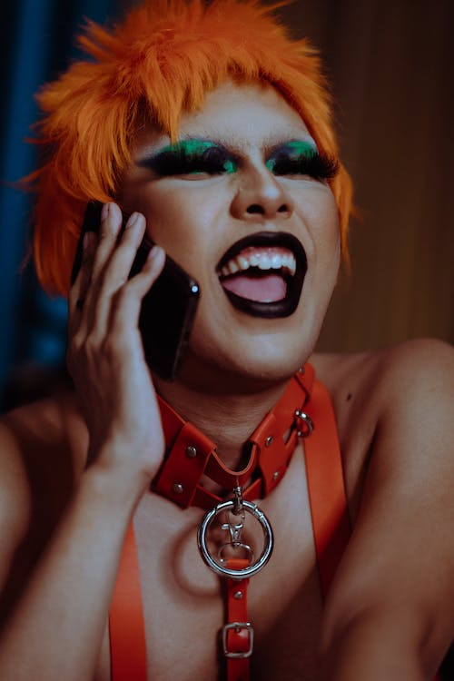
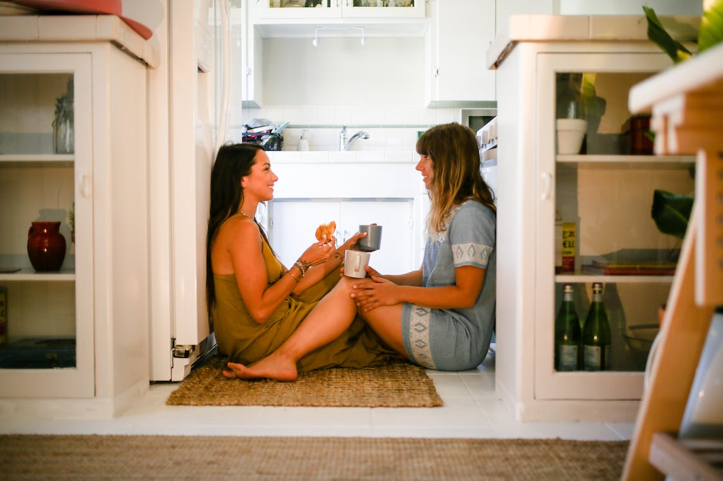
What do these pictures have in common?
Images courtesy of pexels.com

Slide 4
Reflection
What was the most important thing you learnt about communication online?
How is communicating online similar to communicating in person?
How is communicating online different to communicating in person?
What are the issues of communicating online?
What steps can you take to ensure the well-being of yourself and those close to you while utilising a mobile device or the internet?

